Slide 1
NER SkillFinder
Prof. Dr. Kurt Englmeier
Hochschule Schmalkalden Fakultät Informatik
Course : TAaDS
TEAM : 03
TOPIC : 07

Slide 2
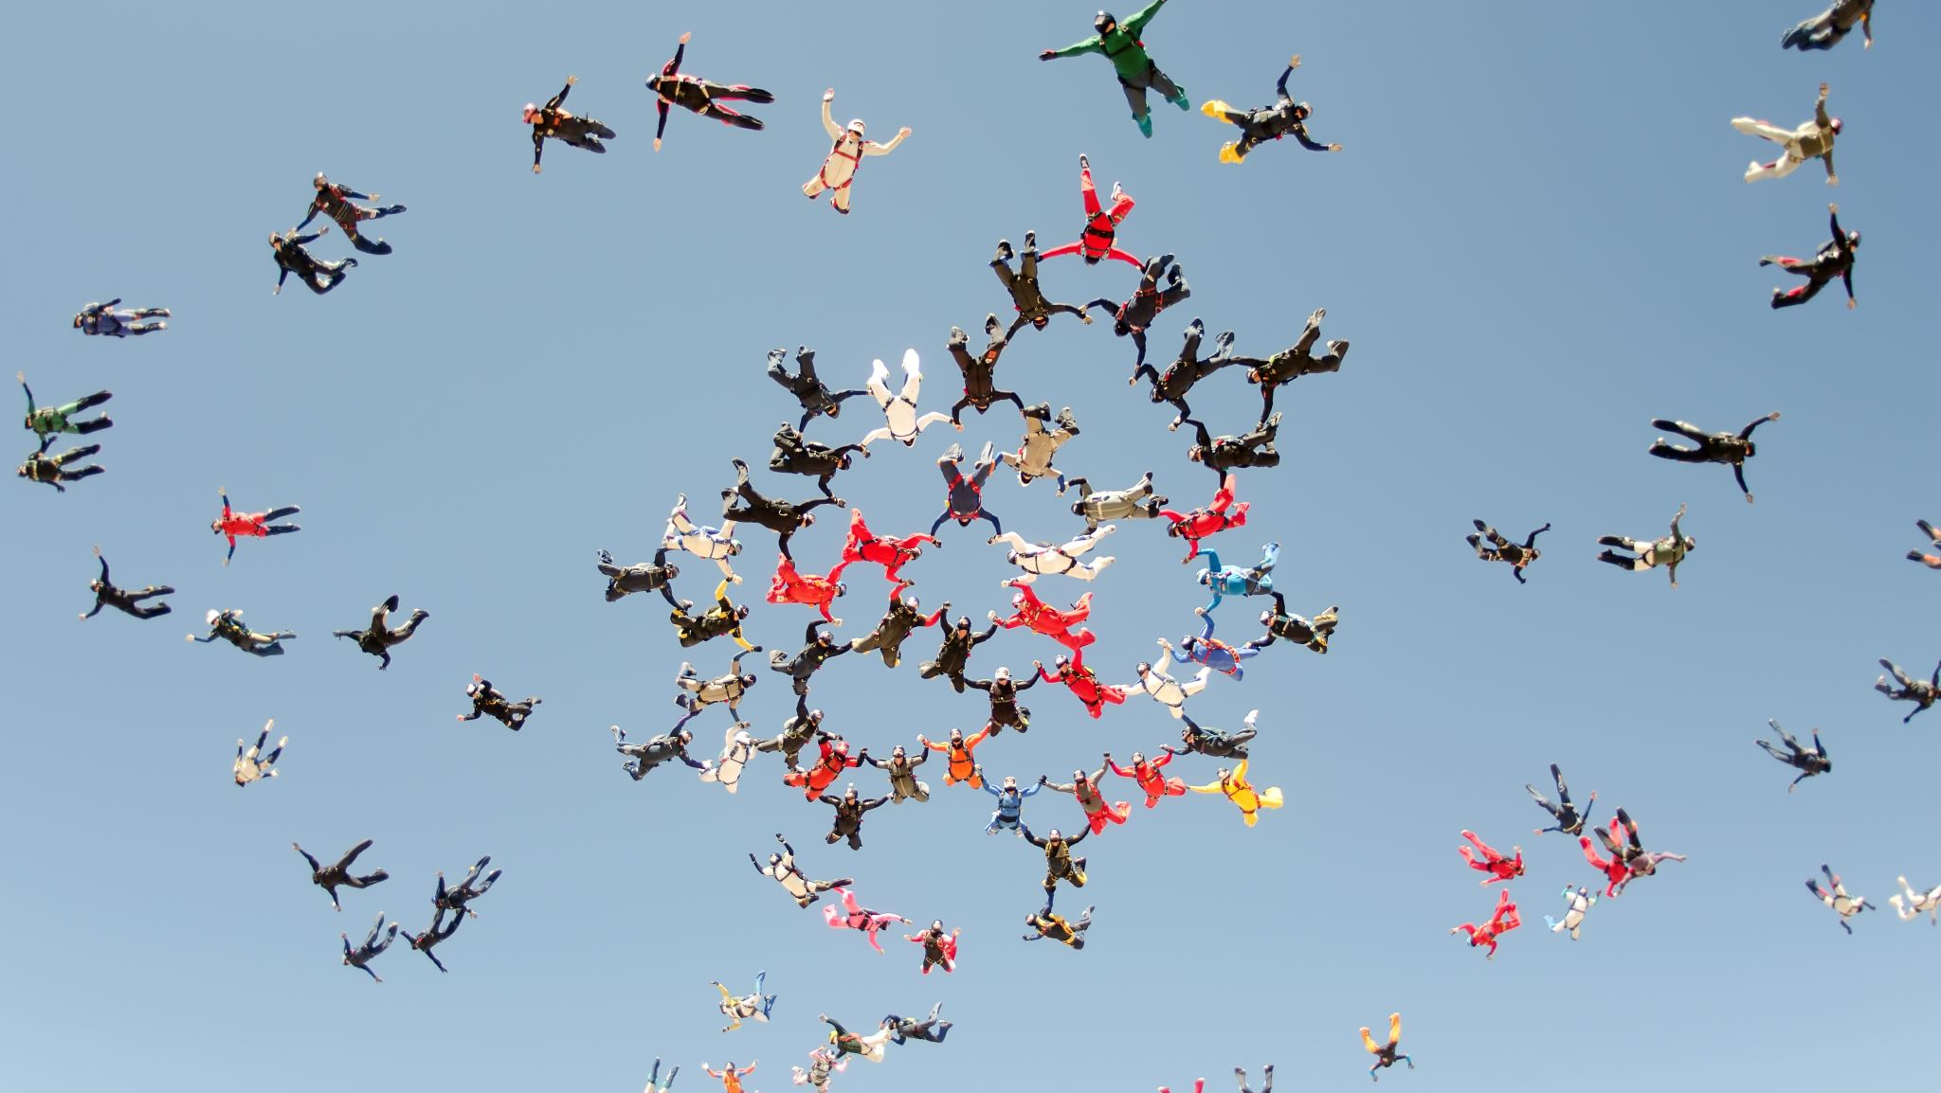
TEAM MEMBERS
SHETU CHOWDHURY
AIMAD ESSAKI
MANAR ZAIN EDDIN

Slide 3

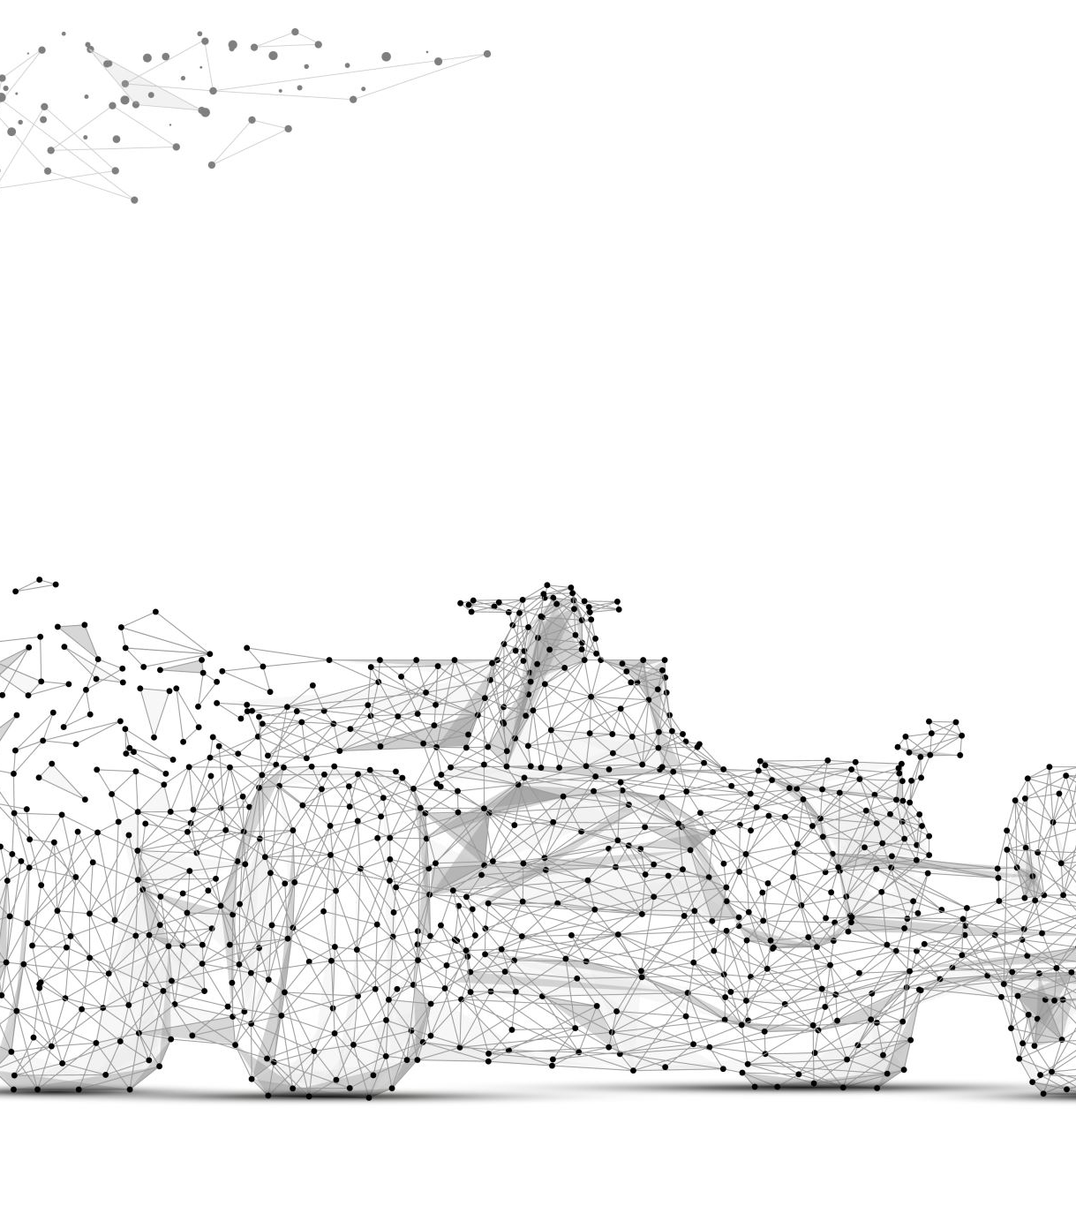
Overview
Extract date & training NER
Most Frequent job Skills with trained NER model
Errors in custom trained model
Skill identification with new library
Comparison of identified skills

Slide 4
Extract Data & NER training model
Perform Pre-Processing on Unstructured Text data.
Use Pre-Trained Model to Test the Pre-Processed data.
Create a Training dataset by annotating word or Phrases.
Build a custom Trained Model.
Perform NER with the prepared text data and Identify Word or Phrases which represent Skill in a Job advisticement.
TEXT | START | END | LABEL
Telemarketing | 1 | 15 | Skill
Python | 44 | 54 | Skill
Notes:
NER Text Annotation
https://tecoholic.github.io/ner-annotator/

Slide 5
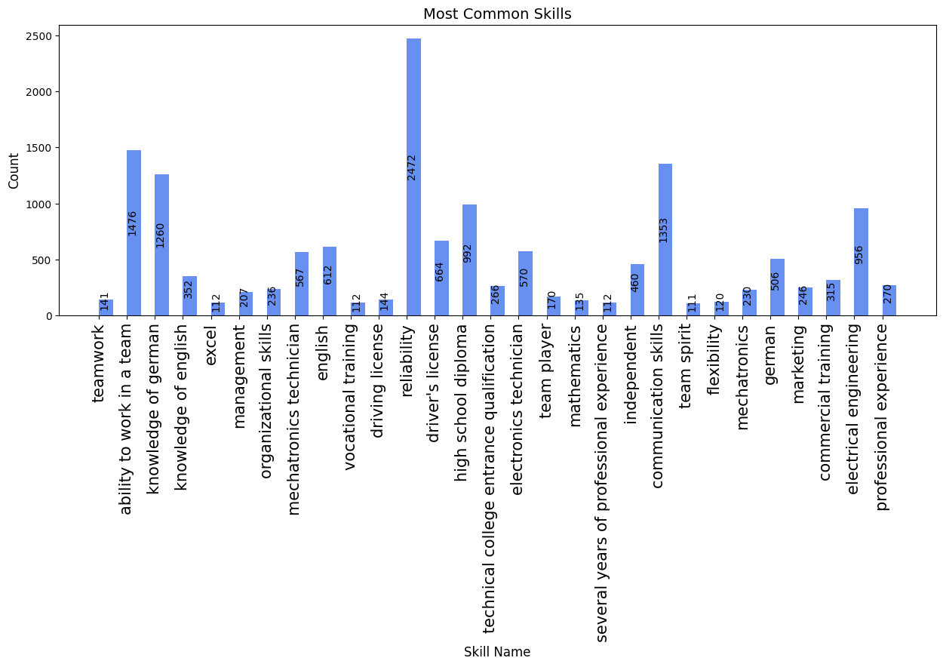
Most Frequent Job Skills
Notes:
Most frequent Skills

Slide 6
Errors in Custom Trained Model
For First 2000 Jobs
Predicted Skills | Actual Skills | % of Error
18755 | 14809 | 29%
Notes:
% = ((true – predicted) / true ) * 100%
Predicted Skills
Actual Skills
% of Error

Slide 7
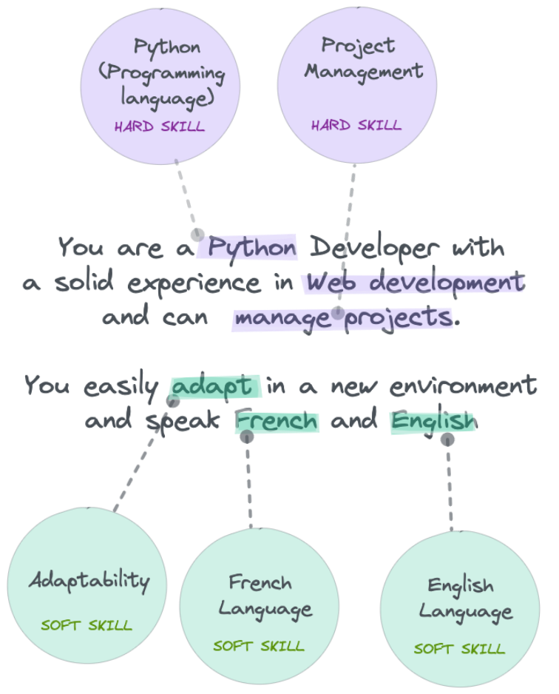
New Library: SkillNer
SkillNer is the first Open Source skill extractor.
A data-driven method for automatically extracting soft skills from any text.
Skillner uses EMSI databse (an open source skill database) as a knowldge base linker to prevent skill duplications.
Can Identify both Soft and Hard Skills.
SkillNer trained with a support vector machine (SVM) on a corpus of more than 5000 scientific papers [1].
Notes:
Link for information
GitHub - AnasAito/SkillNER: A (smart) rule based NLP module to extract job skills from text
SkillNER: Mining and mapping soft skills from any text – ScienceDirect
SkillNer : skills extractor and more
Just get the idea

Slide 8
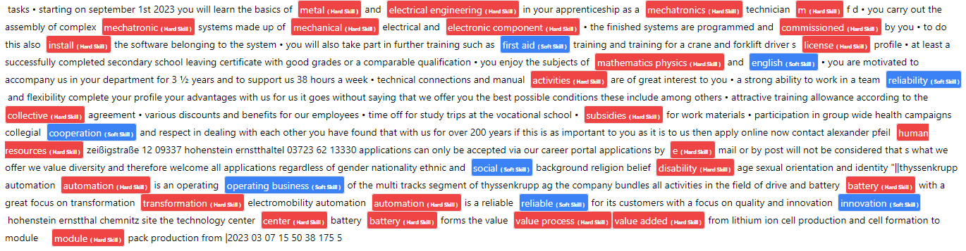
Results of SkillNer
Notes:
Red = Hard Skills
Blue = Soft Skills

Slide 9
SpaCy Custom Trained Model Vs SkillNER
Custom Trained Model | SkillNer
linchpin in the electrical sector | electrical
Oberschwaben as an electrician | electronics service
electronics technician | electronics service
service technician | automation
several years of | develop personally
MSR environment | addition
training as a master craftsman | collective
knowledge of measurement | automation
control and regulation technology | electronics technician
basic process engineering knowledge | master craftsman
experience in technical service | control
Communication skills | basic process
teamwork | process knowledge
reliability | engineering professiona
motivation | professional
high flexibility | technical service
English knowledge in spoken and written | pharmaceutical
 | communication skills
 | teamwork
 | realibility
 | english

Slide 10
Limitations
Working with Unstructured Text data always difficult.
No Training data available. We had to prepare manually.
It is difficult to evaluate model or final outcomes if we have large text data.
Difficult to label the Separated Skills
Python → Programming skills
Working as a SW developer → Experience
Notes:
This is overall limitation: Our Custom Train model and also working with unstructured Text data.
It is difficult to perfom NER to a perticular area of text, when It is unknow, where exaclty skills avalibal. Performing NER to entire job descrition will lead wrond ner identification
We had to prepared our own training data. Which is quite difficult, also it could contain wrong tag. Ultimately lead to wrong predictions
Normally Machine Learning model has many tools or options to evaluate model
We did not able to give a proper tagging or proper descriptio of identified ner. For example python as programming language and several years of experience as experience

Slide 11

THANK YOU

